Slide 1
METEOROLOGICAL ENVIRONMENT

Slide 2
The elements which comprise the meteorological environment are:
Atmospheric pressure
Air temperature
Humidity
Rainfall
Direction and speed of wind
Movement of clouds and character of weather

Slide 3
Climate
The term “climate” is a geographical concept representing a summation of the whole range of meteorological phenomena.

Slide 4
Atmospheric pressure
The atmospheric pressure at earth’s surface close to the sea level averages 760 mm of Hg.
This is called “one atmosphere of pressure”.
Man is physiologically adapted to live at 760 mm of Hg pressure or close to it.
The atmospheric pressure falls as altitude increases and rises as altitude decreases. Thus, at an altitude of 100,000 feet above mean sea level, the atmospheric pressure is less than 10 mm. of Hg.
The pressure increases at the rate of “one atmosphere” for each 33 feet depth below sea level.

Slide 5
Barometer
The instruments used for measuring atmospheric pressure are known as barometers of which there are three well known kinds :
Fortin’s Barometer;
Kew Pattern Station Barometer
Barograph.
The Kew Pattern Station Barometer is widely used by the Indian Meteorological Department for measuring the atmospheric pressure.
Barograph is an instrument for obtaining a continuous record of atmospheric pressure. It is a circular box, the walls of which collapse or distend when the atmospheric pressure rises or falls.

Slide 6
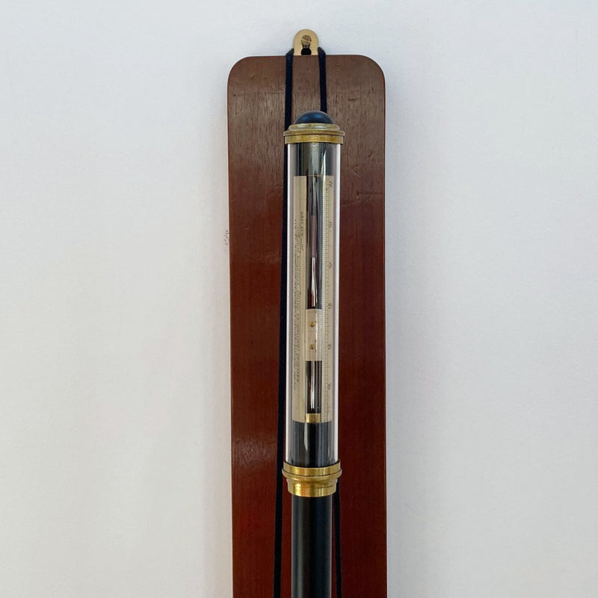
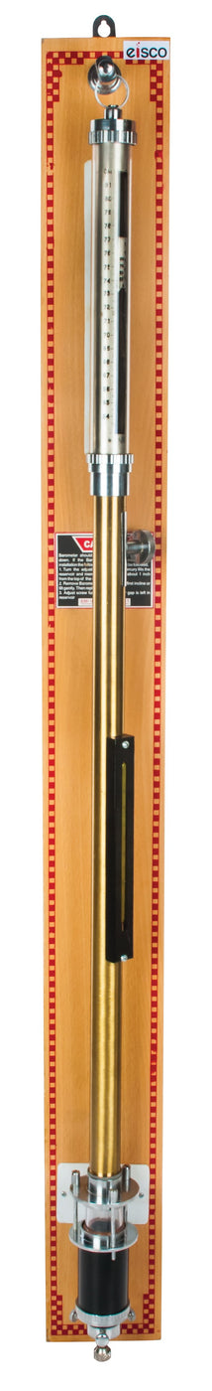
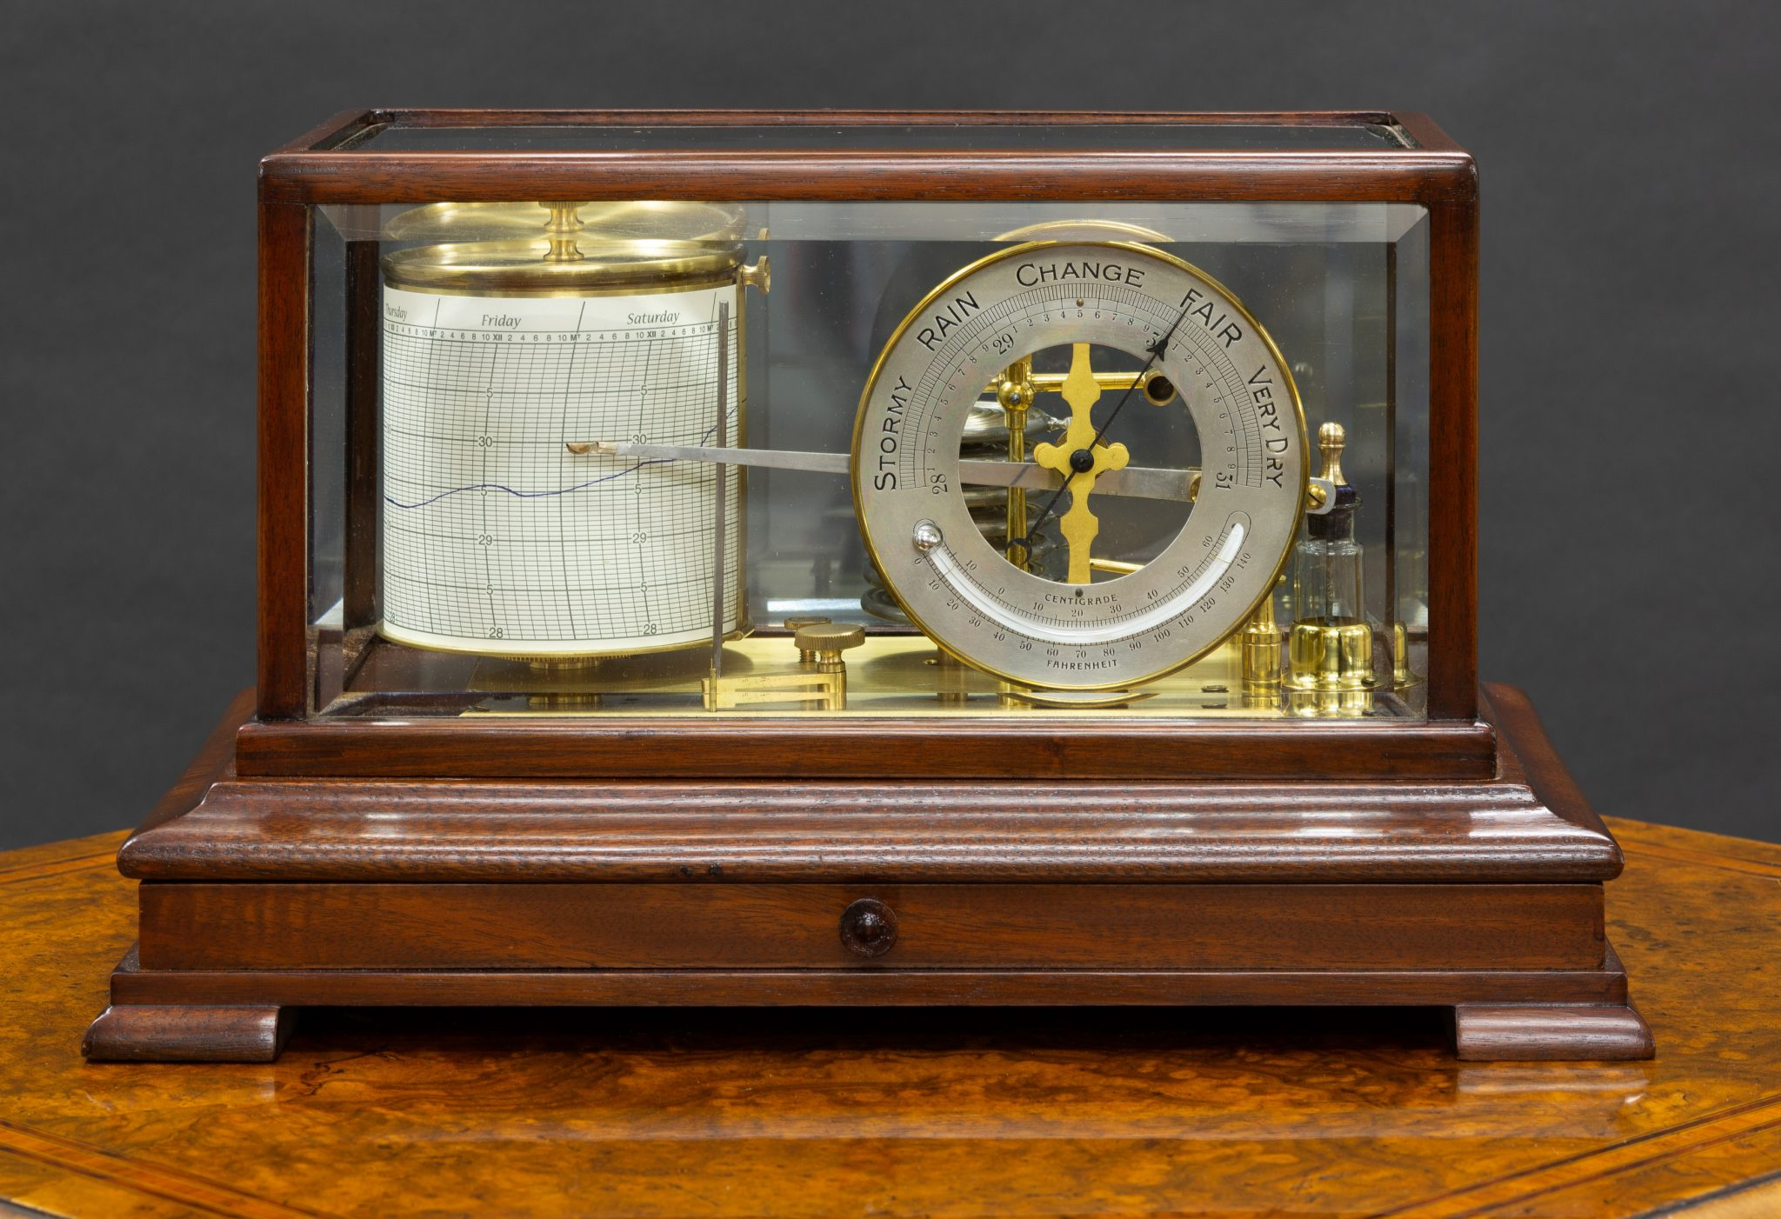

Slide 7
Effects of atmospheric pressure on health

Slide 8
HIGH ALTITUDES
The air is less dense at higher altitudes, and consequently the partial pressure of oxygen is also less.
Man cannot survive at an altitude of 25,000 feet without breathing equipment.
When man is exposed to low pressures, the physiological effects are :
Increase in respiration
Increase in the concentration of hemoglobin
Increase in cardiac output

Slide 9
Two conditions have been described as a result of sudden exposure to high altitude :
Acute Mountain Sickness : This is a relatively common, harmless, and transient condition characterised by headache, insomnia, breathlessness, nausea, vomiting and impaired vision.
It has not been conclusively proved whether all these symptoms are due to the effect of hypoxia or due to the various intricate biochemical and hormonal disturbances in the body.
High Altitude Pulmonary Oedema : The symptoms generally appear on about the third day at high altitude and are indistinguishable from those of ordinary mountain sickness.
But as pulmonary oedema develops, the patient develops a cough, and may experience irregular or Cheyne Stokes breathing, oligurea, mental confusion and hallucinations, stupor, seizures and coma. The condition is rare below 12,000 ft. (3,600 m.).
The condition does not respond to antibiotics

Slide 10
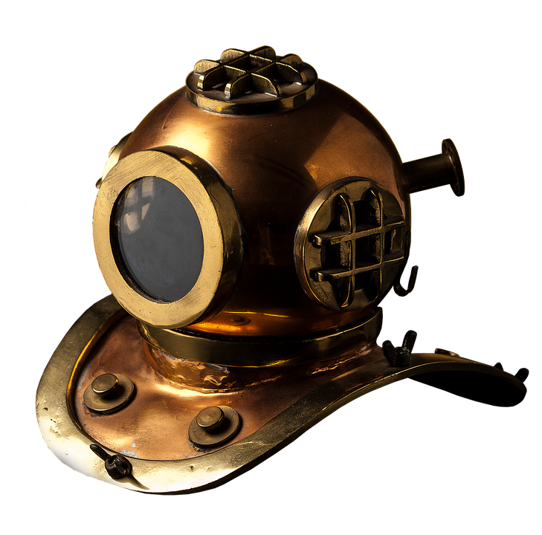
LOW ALTITUDES
The atmospheric pressure increases by one atmosphere for every 33 feet depth below sea level.
The greatest depth so far reached are the equivalent of 10 atmospheres.
When man is exposed to high pressure, the gases in the air namely oxygen, carbon dioxide and nitrogen are dissolved in the blood and tissues proportionately to the partial pressure of these gases.
Excess concentration of nitrogen excerts a narcotic action leading to loss of mental functions and consciousness; excess of carbon dioxide increases the narcotic action of nitrogen; excess of oxygen can lead to convulsions and death.
When the person comes up to the surface, the gases which are dissolved in the blood under pressure are released and cause air embolism, the effects of which are fatal.
The effects of increased pressure are best observed in persons working in diving bells and compressed air chambers (Caisson disease).

Slide 11
AIR TEMPERATURE
The temperature of air varies in different parts of the day and also in the different seasons.
The factors which influence the temperature are :
Latitude of the place
Altitude
Direction of wind
Proximity to sea
The temperature of the ground surface is always higher than that of the air.

Slide 12
MEASUREMENT
Thermometers are instruments used for measuring temperature.
Mercury thermometers are widely used, as mercury boils at a high temperature, has a regular expansion an its level can be easily seen.
Alcohol thermometers are a so used, alcohol has the advantage of not solidifying even at the lowest known temperature.

Slide 13
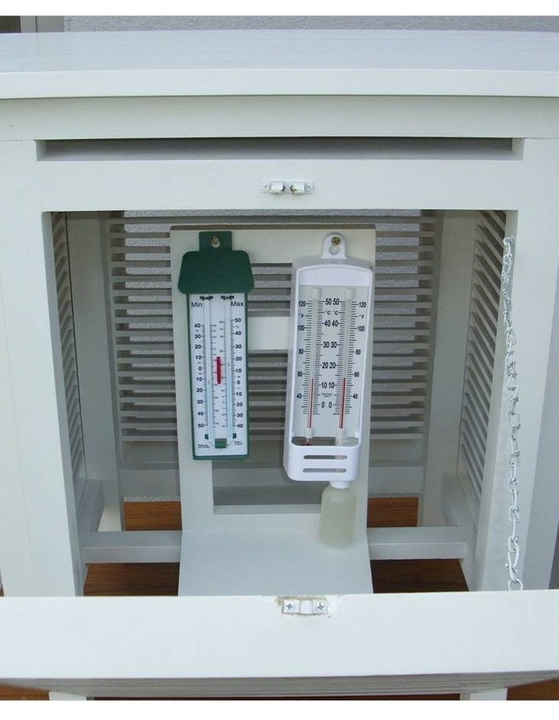
The essential condition for the use of the thermometers are that:-
(1) The air should have free access to the bulbs of the thermometers
(2) The thermometer should be protected against radiant heat.
These conditions are fulfilled by mounting the thermometers on a special approved screen called the “Stevenson Screen" which is used in all the meteorologies observatories in India.

Slide 14
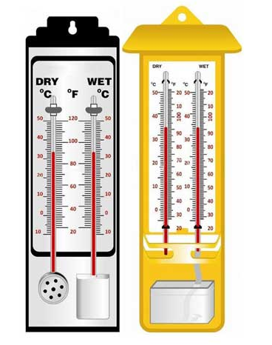
Dry bulb thermometer
This is an ordinary thermometer which measures the air temperature. For accurate readings, it is mounted on the ‘Stevenson Screen , at a height of 1.20 to 1.80 m above the ground level.
The screen protects against radiant heat, direct sun and rain.

Slide 15
Wet bulb thermometer
The wet bulb thermometer is precisely the same as the dry bulb thermometer excepting that the bulb is kept wet by a muslin cloth fed by water from a bottle through a wick.
The evaporation of water from the muslin cloth lowers the temperature of the mercury.
The wet bulb thermometer therefore shows a lower temperature reading than the dry bulb thermometer.
The drier the air, the lower the wet bulb reading.
If the wet and dry bulb thermometers record the same temperature, it means that the air is completely saturated with moisture, which is rare.

Slide 16
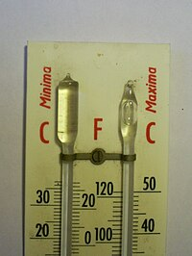
Maximum thermometer: This is a mercury thermometer so designed that there is a very fine constriction near the neck of the bulb.
When the temperature rises, mercury expands; when the temperature falls, mercury cannot get back into the bulb. The end of the mercury thread at the distal end gives the maximum temperature reached.
Minimum thermometer: The liquid inside the minimum thermometer is spirit, in which is immersed a dumb-bell shaped index.
When the temperature falls, the spirit drags the index towards the bulb end; when the temperature rises, the spirit expands and runs past the index.

Slide 17
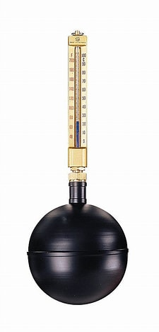
Globe thermometer
The globe thermometer is used for the direct measurement of the mean radiant temperature of the surroundings.
The instrument consists of a hollow copper bulb 6 inches (15 cm) in diameter and is coated on the outside with matt black paint which absorbs the radiant heat from the surrounding objects.
A specially calibrated mercury thermometer is inserted, with its bulb at the center of the globe.
The globe thermometer registers a higher temperature than the ordinary air temperature thermometer because it is affected both by the air temperature and radiant heat.
The difference between the globe thermometer temperature and that of the ordinary dry bulb is a measure o the radiant heat.

Slide 18
Wet globe thermometer
This instrument is designed for environmental heat measurement.
It consists of a dial thermometer with the heat sensing portion enclosed by a blackened copper sphere that is completely covered with wet black cloth.
The Wet Globe exchanges heat with the surroundings by conduction, convection, evaporation and radiation similar to the way a perspiring man does, so the equilibrium temperature of the globe provides a comprehensive measure of the cooling capacity of the work environment.

Slide 19
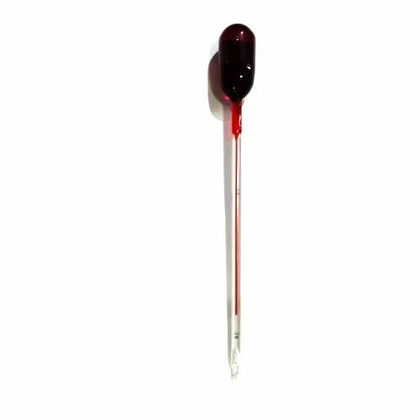
Kata thermometer
The word “kata” is a Greek word meaning “down”.
The Kata thermometer is an alcohol thermometer with a glass bulb 4 cm long and 1.8 cm in diameter.
The readings on the stem are marked from 100 deg. to 95 deg.F.
Two instruments are used, the bulb of one is covered with a wet muslin cloth, the wet kata and the other dry kata.

Slide 20
Kata thermometer
Before taking the readings, the bulbs are immersed in hot water to warm them slightly above 130 deg. F, when the alcohol rises into a small reservoir at the top of the instrument.
The bulb of the dry Kata is wiped dry.
Then both the instruments are suspended in air at the point of observation. The time in seconds required for the spirit to fall from 100 deg. to 95 deg.F is noted with a stop watch. This is repeated at least 4 times.
The first reading is discarded and the average of the last three is taken. The length of time depends upon the “cooling power” of the air. Each Kata has a “factor” called the Kata Factor marked on the stem.

Slide 21
Heat stress indices
Heat stress is the burden or load of heat that must be dissipated if the body is to remain in thermal equilibrium.
The factors which influence heat stress are metabolic rate, air temperature, humidity, air movement and radiant temperature.
The amount of heat gained by the body must be equaled by the amount of heat lost from it.
Many heat stress indices have been devised, but none is adequate to be valid in all possible complexities of work rate, air temperature, air movement, etc. These include :
Equatorial Comfort Index
Heat Stress Index
Predicted Four Hour Sweat Rate (P4SR)

Slide 22
Effects of heat stress
As many as 14 disorders resulting from exposure to heat have been recognized and documented.
The important ones are:
HEAT STROKE
HEAT HYPERPYREXIA
HEAT EXHAUSTION
HEAT CRAMPS
HEAT SYNCOPE

Slide 23

PREVENTIVE MEASURES
Replacement of water
Regulation of work
Clothing
Protective devices
Work Environment

Slide 24
Effects of cold stress
Injury due to cold may be general or local. In general cold injury (hypothermia), the individual is said to be suffering from exposure to cold.
This is characterized by numbness, loss of sensation, muscular weakness, desire for sleep, coma and death.
Local cold injury may occur at temperatures above freezing (wet-cold conditions) as in immersion or trench foot.
At temperatures below freezing (dry-cold conditions) frostbite occurs; the tissues freeze and ice crystals form in between the cells (11). Frostbite is common at high altitudes.
It is extremely important to dress for the temperature with which the part will be in contact.
The affected part should be warmed using water at 44 deg. C.
Warming should last about 20 minutes at a time.
Intake of hot fluids promotes general rewarming.

Slide 25
Global warming
Emission of green-house gases into the atmosphere have been increasing ever since the beginning of the industrial revolution.
A major component of emission of carbon dioxide is from the combustion of fossil fuels.
It is generally conceded that the main effects of this include an increase of about 3°C in the average global surface temperature by the year 2030, a rise in the sea level of 0.1-0.3 meters by 2050, and an increase in the occurrence of extreme climatic events such as cyclones, heatwaves and draughts.
The temperature rise could overwhelm the capacity of many species to adapt.
A change of this magnitude would affect local, regional and global ecosystem, sea levels and ocean currents, prevailing winds, fresh water supplies, agriculture, forests, fisheries, industry, transport, urban planning, demographics and human health.
Some effects are mutually reinforcing, so a small additional change in the existing trend could have massive consequences, in accordance with the mathematics of catastrophe theory (13).

Slide 26
HUMIDITY
Humidity or moisture is always present in the atmosphere. The amount of moisture which air can hold depends upon its temperature.
If the air is cooled, t c excessive moisture precipitates for the particular temperature. This is called Dew Point. Humidity may be expressed as absolute humidity or relative humidity.

Slide 27
(a) ABSOLUTE HUMIDITY: It is the weight of water vapor in a unit volume of air. It is expressed as grammes per kilogram or grammes per cubic meter of air.
(b) RELATIVE HUMIDITY: Relative humidity is the most common way of describing atmospheric moisture. It does not indicate the actual amount of water vapor in the air, instead, it tells us how close the air is to being saturated. The relative humidity (RH) is the ratio of the amount of water vapor actually in the air to the maximum amount of water vapor required for saturation at that particular temperature (and pressure).
RH= (Actual vapor pressure / saturation vapor pressure) X 100%

Slide 28
(c) DEW POINT: It represents the temperature to which air would have to be cooled (with no change in air pressure or moisture content) for saturation to occur.
The dew point is determined with respect to a flat surface of water. When the dew point is determined with respect to a flat surface of ice, it is called frost point.
The dew point is an important measurement used to predict the formation of dew, frost, fog and even minimum temperature.
High due point indicate high water vapor content; and low dew point indicate low water vapor content.

Slide 29
Measurement
There are several instruments which may be used for measuring humidity. The ones commonly used are described below :
DRY AND WET BULB HYGROMETER: This is the most widely used instrument for measuring humidity.
The instrument consists of two similar thermometers - a dry bulb thermometer and a wet bulb thermometer, which are mounted side by side on a stand.
The dry bulb measures the air temperature (DBT). The bulb of the second one is covered with a gauze or wick and is kept moist.
The wet bulb temperature (WBT) is usually lower than the DBT If both the readings are the same, it indicates that the atmosphere is 100 per cent saturated with moisture, which never occurs in reality.

Slide 30
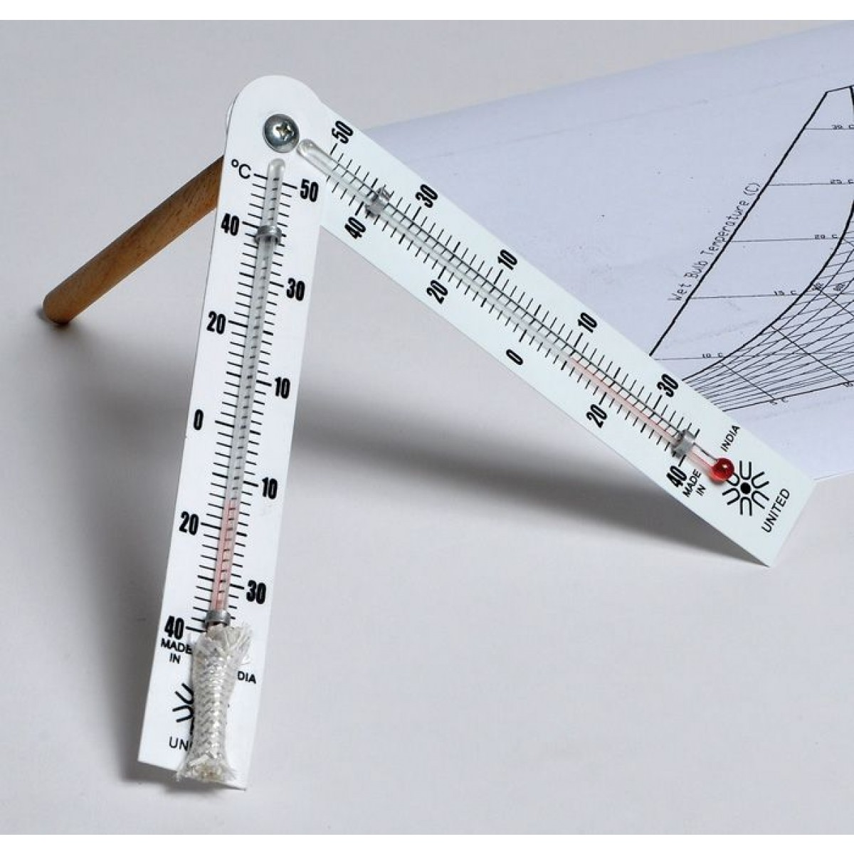
SLING PSYCHROMETER: The sling or whirling psychrometer consists of 2 mercury thermometers (wet and dry) mounted side by side, on a suitable wooden frame, and provided with a handle for rotating the instrument.
The underlying principle is that by rotating, the bulbs arc exposed to air at a definite velocity.
The wet bulb is first moistened with distilled water and the instrument is whirled or rotated standing with the back to the sun, for about 15 seconds at the rate of 4 revolutions per second, so as to obtain the desirable air speed of about 5 metres per second.
The reading of the wet bulb is then noted.
The instrument is again whirled for about 10 seconds and the wet bulb reading is noted.

Slide 31
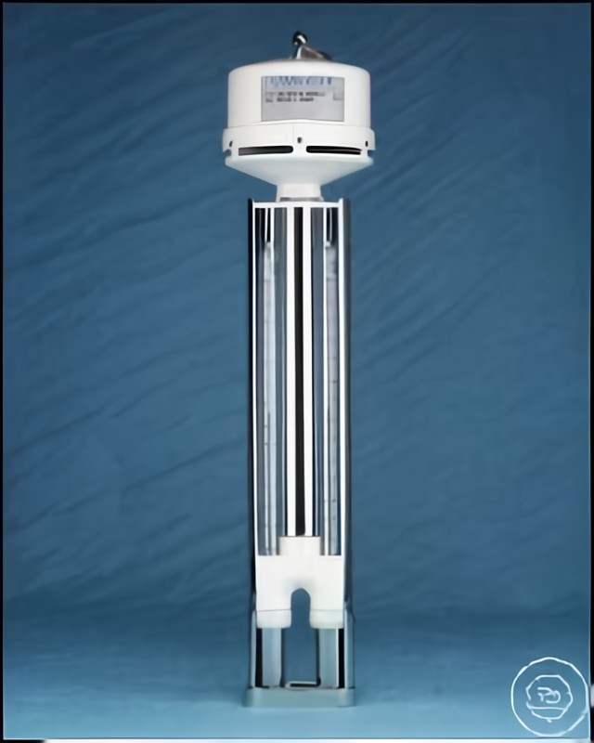
ASSMANN PSYCHROMETER: This is a portable instrument specially designed to give accurate measurement of the wet and dry bulb temperature of the air.
In this instrument, air is drawn at a speed higher than 5 metres per second by a clock-work fan.
The bulbs of the thermometer are protected from the effects of solar radiation so that the instrument can be used even in strong sunshine.

Slide 32
PRECIPITATION
The term precipitation is the collective term used for rain, snow, hail, dew and frost - that is. all forms of water precipitated from the atmosphere. It is measured by raingauges.
The rain-gauge prescribed by the Government of India for use at rainfall measuring stations in India is known as the “Symons Rain-gauge”.
The funnel for receiving the rainfall has a diameter of 5 inches.
Great care is exercised in selecting a suitable site for the erection of rain-gauge. The Rain-gauge should be set on a level ground, away from trees, buildings, or other obstructions.

